Slide 1
Machine Learning in 5g Beamforming

Slide 2
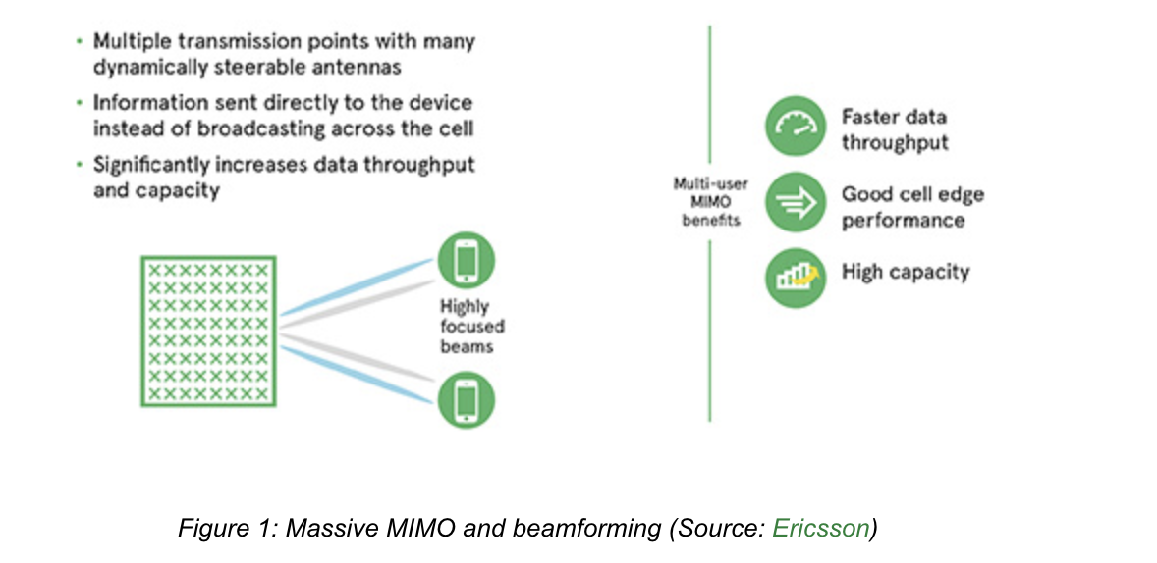
5g Beamforming
Beamforming uses phased array antenna systems to focus the wireless signal toward a specific receiver or target instead of an omnidirectional broadcast.
The physical structure needed to implement beamforming is an array of antennas regularly spaced in two dimensions. The direction of the emitted beam is determined by controlling the phases and amplitudes of the signals sent to the individual antennas, resulting in constructive interference in the desired direction and destructive interference in other directions.
Some of the benefits of beamforming include:
Improved signal quality
Reduced interference
Increased range
Reduced power requirements

Slide 3
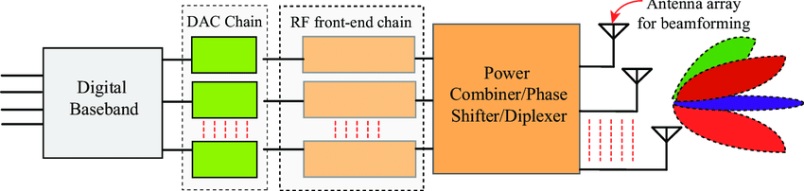
Beam Management in 5G NR (High Level)
Initial access: SSB/Beam sweeping, UE measures RSRP/RSRQ/SINR → selects best SSB beam
CSI acquisition: CSI‑RS (beamformed or non‑precoded), PMI/RI/CQI feedback
Tracking & recovery: periodic/aperiodic CSI‑RS, beam failure detection (BFD), recovery (BFR)
Codebooks: Type‑I/II, DFT‑based beams, hierarchical sweeps
Overheads: sweeping latency, feedback bits, pilot density vs. mobility

Slide 4
ML in beamforming
Learning from data can reduce sweeps/feedback and adapt to mobility/blockage
Framings:
Classification: map context → beam index (top‑k beam candidates)
Regression: predict AoA/AoD, path gains, SNR, or PMI components
Sequence forecasting: next‑beam prediction across time (tracking)
Reinforcement learning: beam selection with reward = throughput/SINR/BLER
Representation learning: CSI compression/denoising, environment embeddings
Where ML plugs in: initial access, beam refinement, tracking, handover, multi‑cell coordination

Slide 5
Features & Parameters can be used
Radio/PHY features
Per‑beam: RSRP/RSRQ/SINR, SS‑RLM, beam index, beam width, boresight angles
CSI‑derived: dominant singular values, angle‑delay power (sparse), Doppler spread
Channel quality: CQI, BLER, HARQ NACK ratio
Mobility: speed estimate, Doppler, timing advance deltas
RF: Tx power, antenna tilt, polarization, carrier frequency, bandwidth, SCS
Context features
UE pose: (x,y,z), heading, IMU, GNSS accuracy flags
Topology: serving/neighbor cell IDs, relative azimuths, PCI, beam codebooks
Environment: LOS/NLOS flag (if available), blockage sensors, map tiles (coarse)
History: last k beams, dwell time, switches, measured SNR trend
Labels/targets
Best beam index/top‑k; expected SINR/throughput; PMI/RI/CQI; handover success

Slide 6
Artificial-Intelligence-Enhanced Beamforming for Power-Efficient User Targeting in 5G Networks using Reinforcement Learning
Recent work that I am looking into.
Key Idea
Use Reinforcement Learning (RL) + adaptive signal processing for beamforming.
System identifies user with lowest power signature and directs beam there, minimizing network energy usage.
Employs MUSIC algorithm for Direction of Arrival (DOA) estimation, then RL adjusts beam weights iteratively
System Assumptions & Setup
Carrier frequency: 28 GHz (mmWave band).
Antenna: Uniform Linear Array (10 elements, half-wavelength spacing).
Modulation: 16-QAM.
Simulation tool: MATLAB with Phased Array System Toolbox.
Two simulated users with random Angles of Arrival (−90° to +90°).
Noise injected to test robustness.

Slide 7
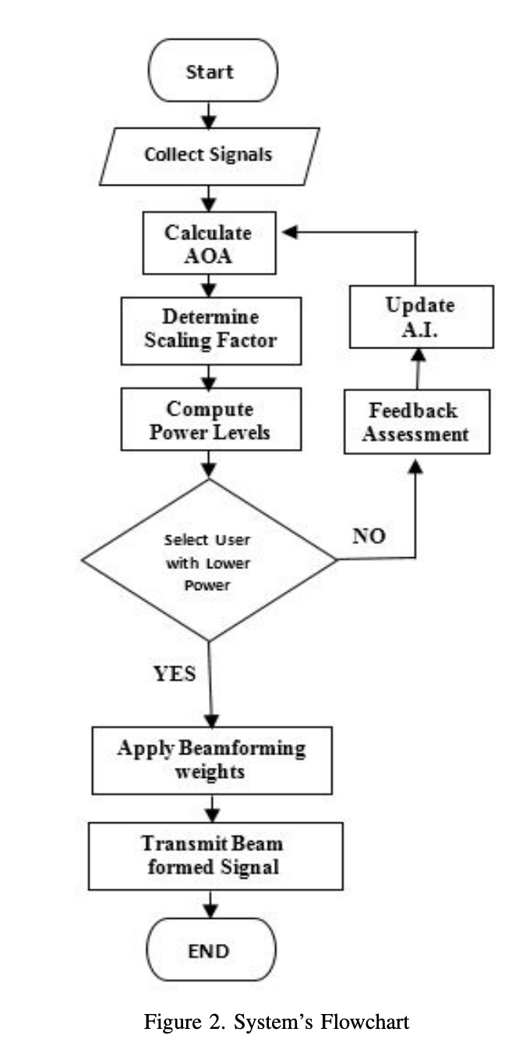
Components:
ULA antenna array – generates beams at 28 GHz.
Signal generation – multiple users, different arrival times.
DOA/AOA estimation – MUSIC algorithm pinpoints signal direction.
RL algorithm – dynamically scales user signals, adjusting beamforming weights in real time.
Beam steering – AI aligns beam to user with lowest power usage.
Noise/interference management – evaluates robustness in practical conditions.
Data & Rewards
Received Signals: The raw signals collected from all active users within the network's range.
Angle of Arrival (AOA): The calculated direction from which each user's signal is arriving at the base station's antenna array. This is a crucial piece of spatial information.
Power Levels / Power Signature: The computed power of each user's signal. This is the most critical data point for the AI's decision-making process.

Slide 8
Mathematical Framework
Array Factor (AF): models beam response of the antenna.
Optimization problem: minimize total transmit power while satisfying QoS constraints (SINR ≥ γ, rate ≥ R).
RL training:
Training phase: learns optimal beamforming weights from CSI.
Execution phase: applies learned weights, adapts in real time.
16-QAM model: BER and throughput equations used for evaluation.
Throughput formula: accounts for retransmissions and BER impact.
Simulation Results
BER vs Eb/No: AI beamforming matches theoretical 16-QAM BER at high SNR; slight gap at low SNR due to real-world imperfections.
Throughput vs Eb/No: maintains throughput even at negative SNR values thanks to strong error correction.
DOA/AOA plots: show accurate direction estimation by AI.
Beam patterns: AI reduces sidelobes, focuses energy efficiently.
Azimuth plots: confirm AI successfully enhances main lobe, suppresses interference.

Slide 9
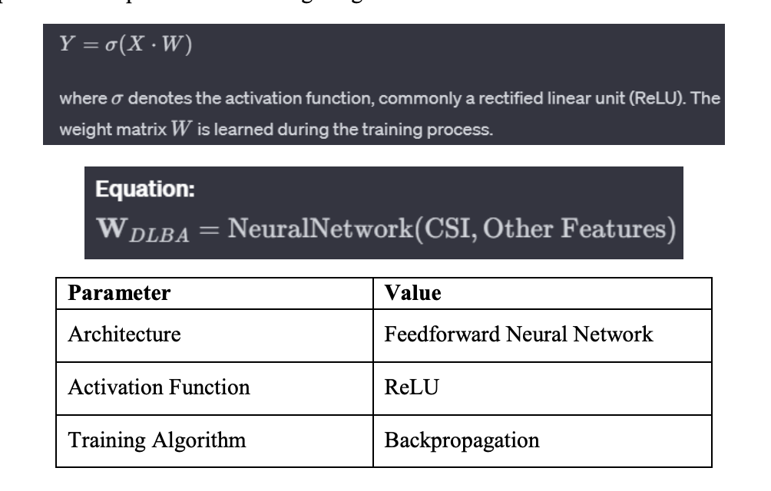
Machine Learning-Based Beamforming Algorithms:
Deep Learning Beamforming Algorithm (DLBA): The Deep Learning Beamforming Algorithm builds on an artificial neural network that learns complicated spatial correlations essential to Massive MIMO systems. The built-in neural network accepts CSI and other related features as inputs, then provides the optimal beamforming weights.

Slide 10
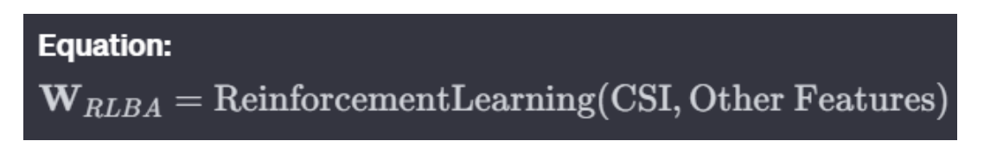
2. Reinforcement Learning-Based Beamforming Algorithm (RLBA): Beamforming strategies are optimized iteratively with the help of Reinforcement Learning-Based Beamforming. State of the environment can be observed by beamformer, and then it determines actions (beamforming weights) in order to optimize system performance as a reward signal.
3.Clustering-Based Beamforming Algorithm (CBA): Clustering-Based Beamforming groups users with similar channel characteristics into clusters and beamforming weights are derived based on the centroid of each cluster. This method focuses on the similarities of channel responses within a group.

Slide 11
Performance Metrics:
Three key performance metrics were selected to assess the algorithms:
● System Throughput: In bps, meaning the total transmission rate of data.
● Signal-to-Interference-plus-Noise Ratio (SINR): Measures the quality of received signal in comparison with interferes and noise.
● Bit Error Rate (BER): It is the ratio of erroneously received bits to total transmitted ones
The algorithms’ efficiency will be evaluated by the system throughput, SINR and BER key metrics. These statistics will offer an overall view of the impact that algorithms have on improving communication quality in Massive MIMO systems under a 5G environment.

Slide 12
Algorithm | Type | Key Features
Deep Learning Beamforming | Neural Network-based | - Utilizes a neural network to learn spatial relationships in CSI. Requires training on diverse datasets.
Reinforcement Learning Based Beamforming | Reinforcement Learning | - Formulates beamforming as a sequential decision-making process.Learns through interaction with the environment.
Clustering-Based Beamforming | Clustering | - Groups users into clusters based on channel characteristics.Exploits similarities within clusters for beamforming.

Slide 13
Data
In doing so for this study, we use a well-rounded dataset of CSI which were collected from an MIMO system that is put in the simulated environment of 5G. The dataset covers a wide range of situations, such as multiple user distributions, motion patterns and channel configurations so that our machine learning based beamforming algorithm has been validated in various scenarios demonstrating its generality. The CSI data is a collection of matrices that represent the channel response between multiple antennas at base stations and corresponding ones on user devices. Each matrix represents the channel characteristics, including amplitude and phase; hence we can model the spatial effects of wireless communication. The training and evaluation phases are facilitated by preprocessing the dataset to deal with noise, outliers absence values

